Slide 1
Review of group 13
Group Member in Group 12:
Chenyang Song
Xiaoyi Wang
Tingge Yao
Haiwei Yong

Slide 2
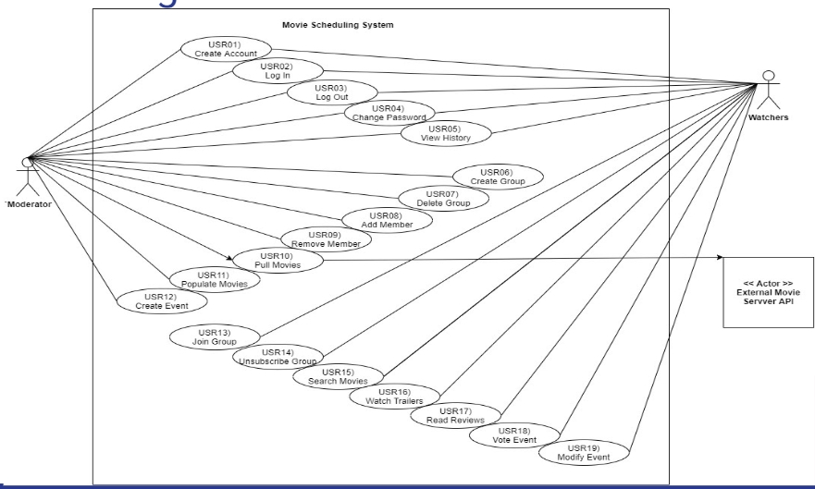
Use case diagram review
Use case might not be a feature
Use case diagram shouldn’t be another feature diagram. This is a general mistake during design process.
Feature is from a developer’s view, but use case is from a user’s view.
So the point of the diagram is seeing problems from view of the users.

Slide 3
Use case diagram review
Issue1:
Use case 19:
“Watchers----- Modify Event” should be “Watchers-----Modify vote”. not corresponding to your specification.

Slide 4
Use case diagram review
Issue2:
There is no “ view winner” use case, which should have association with both moderator and watchers

Slide 5
Use case specification review

Slide 6
USR01: Create Account
Problem lays on:
The actor won’t have their different privileges unless they have different kind of account.
Why it is essential:
To be consistent with USR02, which declares that after creating the account, moderators and watchers can log in to the system with their specific privileges.
How to modify:
The “create account” step should separate to two categories for two kinds of identity: moderators and watchers.

Slide 7
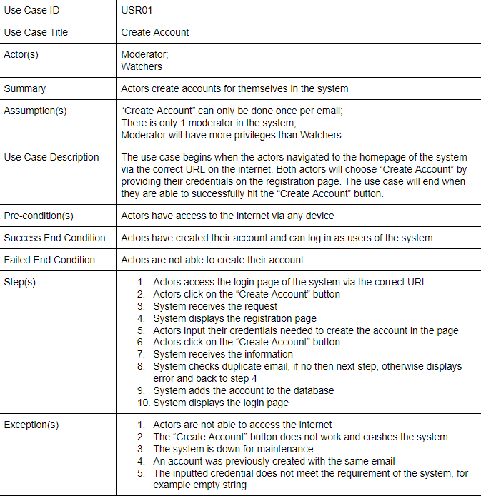

Slide 8
USR08: Add Member
Problem lays on:
Actors can not select interested watchers because the system will never show all watchers to the moderator and let actors pick. The moderator can only invite people by typing their information.
Why it is essential:
If the moderators can see all watchers, it will violate the Internet privacy.
How to modify:
Let the moderator input watchers’ emails to invite watchers.

Slide 9
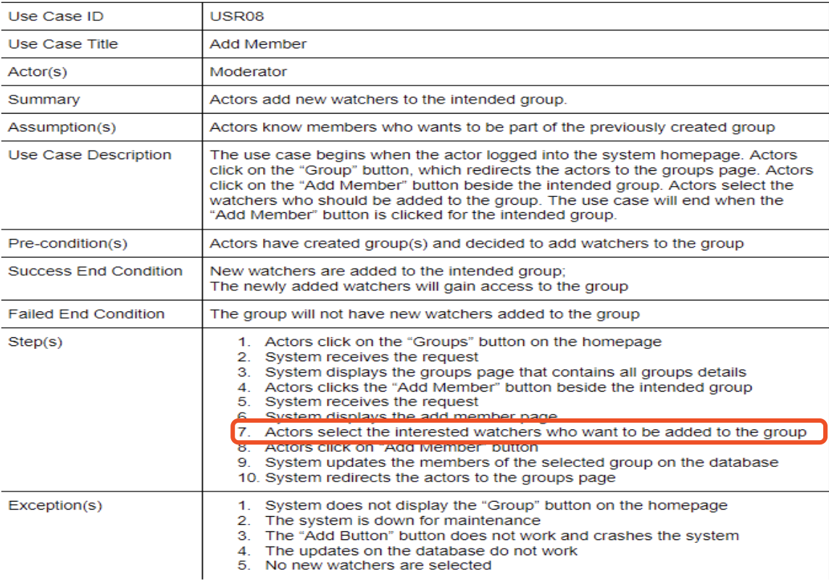

Slide 10
USR12: Create Event
Problem lays on:
The specific time when an event begins hasn’t been declared: both in use case specification and class diagram fields.
Why it is essential:
To meet the requirement. The requirement asks that a event should have its begin date and time.
How to modify:
Add the time when the event begins when creating event. Also do relevant design in class diagram: add a field named eventTime, which is implemented by a String.

Slide 11
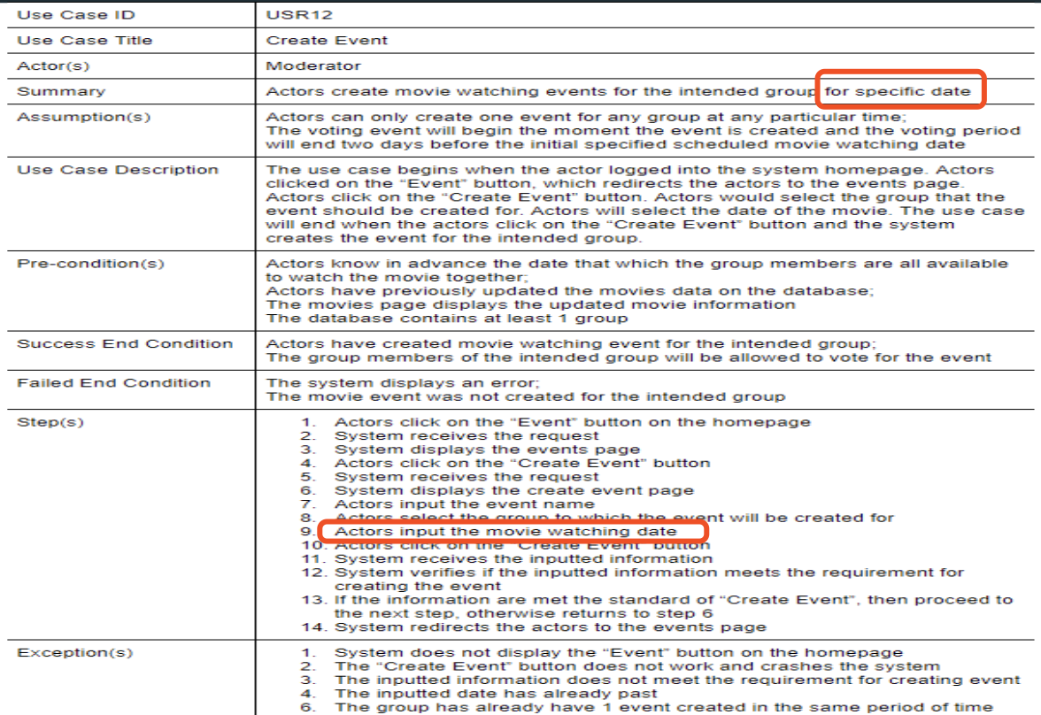

Slide 12
USR13: Join Group
Problem lays on:
Watchers receive the email invitation, however, this function haven’t been declared in the USR08.
Why it is essential:
To be consistent with “add member”, which never sends any notification to members.
How to modify:
The “add member” use case should add one step: send notification through email.

Slide 13
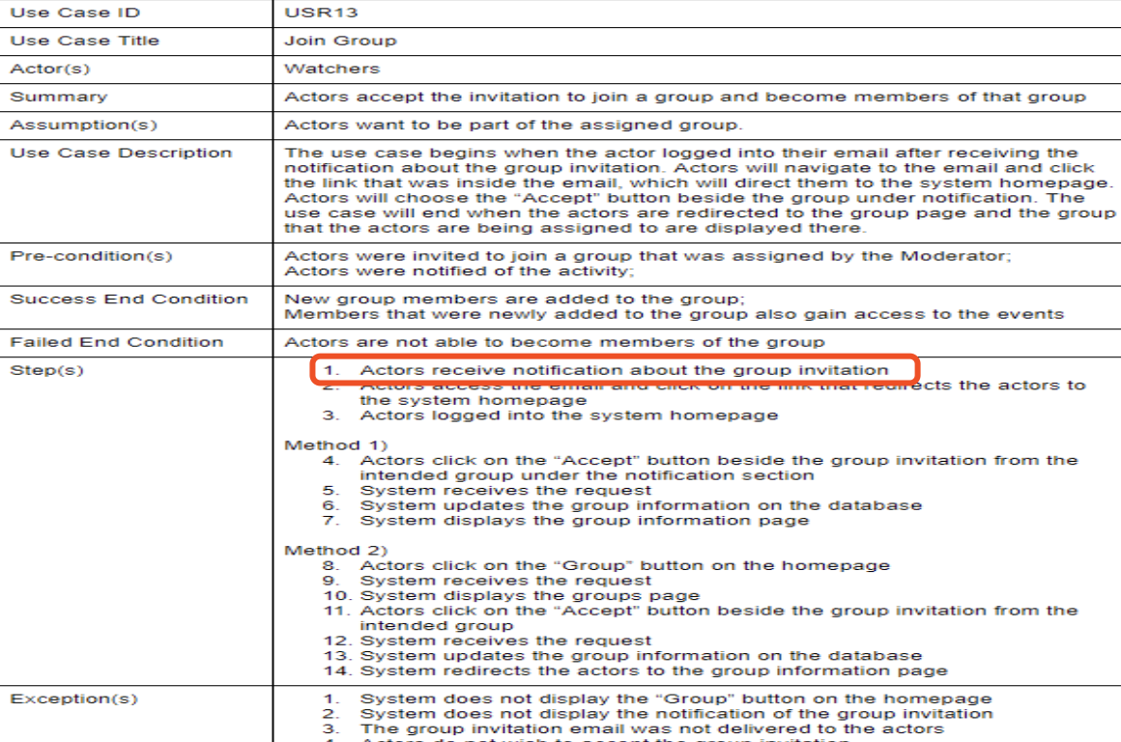

Slide 14
USR15: Search Movies
Problem lays on:
The definition of searching movies is ambiguous. It seems like watchers can search every movie in the database rather than those in a specific movie list.
Why it is essential:
It may leads confusion because actors should only be allowed to search among movie list.
How to modify:
Change the expression.

Slide 15
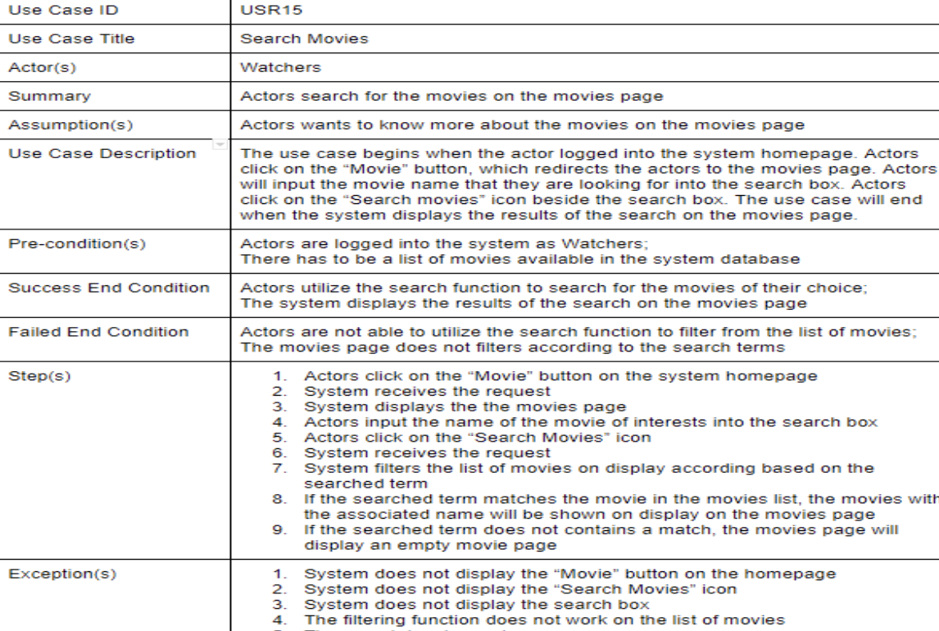

Slide 16
USR16/17: Watch Trailer/Read Review
Problem lays on:
The step one of these two cases is searching movies, which should belongs to previous use case.
Why it is essential:
Steps and pre-conditions are different.
How to modify:
Move “actors have searched the specific movie” to the preconditions of this use case.

Slide 17
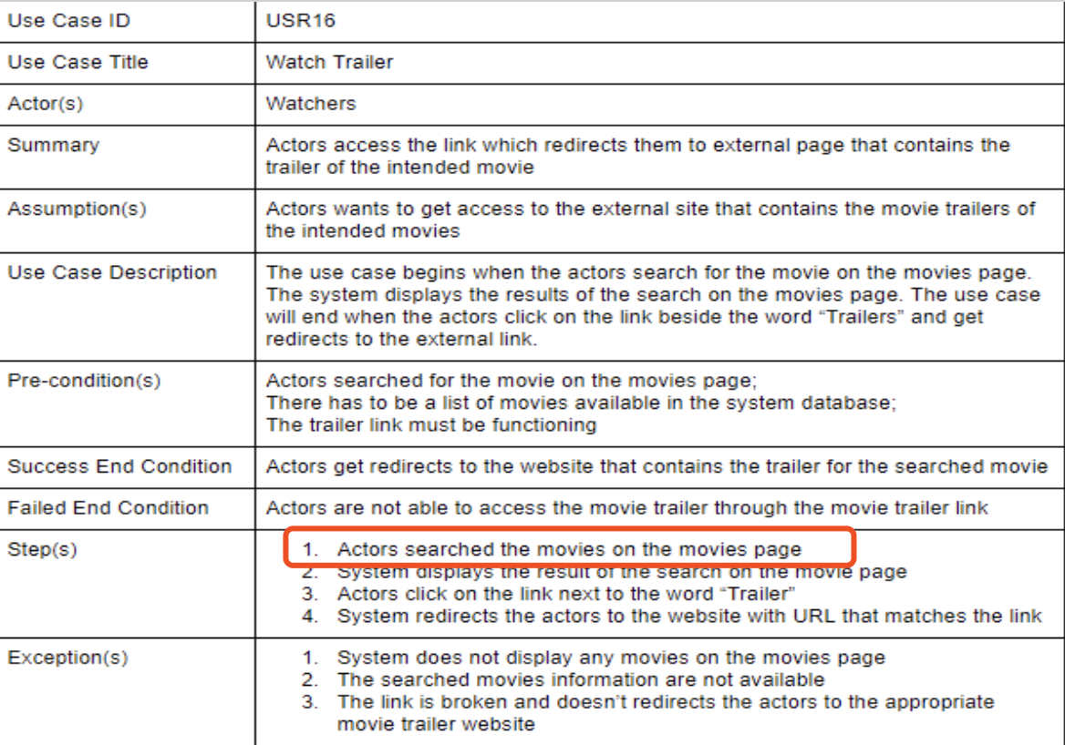

Slide 18
USR18： Vote Event
Problem lays on:
The precondition of USR18 is that actors received notification about the voting event, however, there is no use case specification mentions notifications have been sent.
Why it is essential:
To achieve consistency.
How to modify:
Add the function of sending notification to a suitable use case.

Slide 19
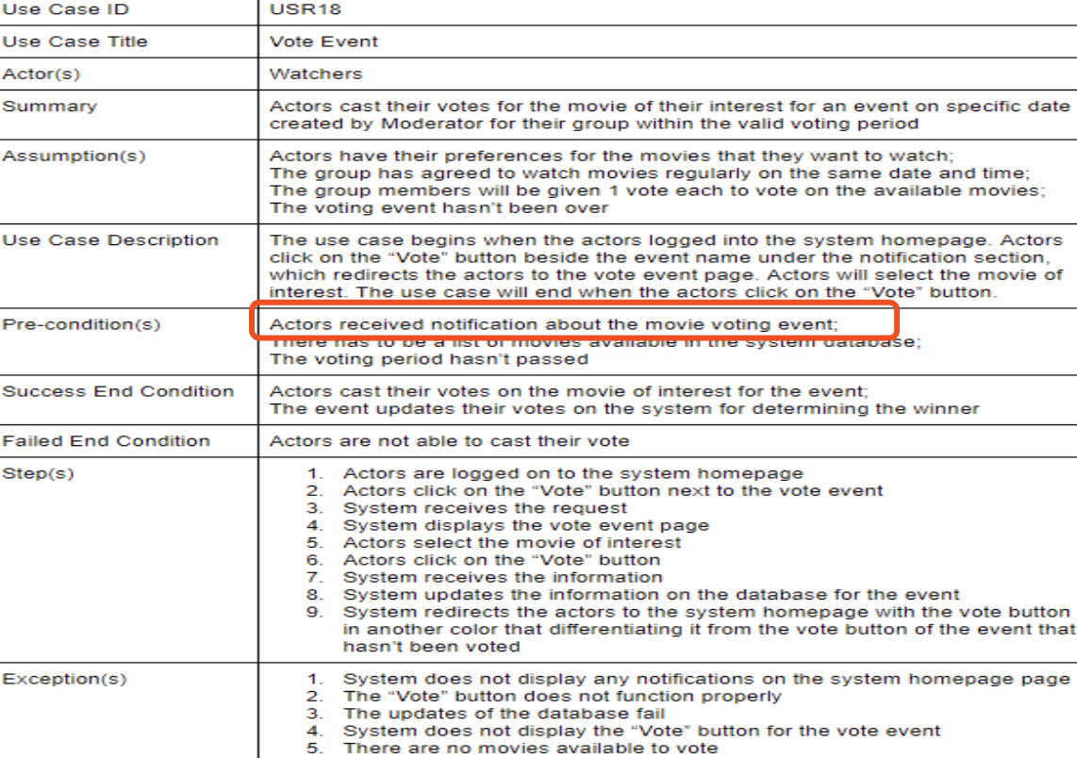

Slide 20
USR19： Modify Vote
Problem lays on:
Because there is already existed “vote event”, only “cancel vote” is needed to do the modification. From other perspective, “modify event” contains “vote event”, “cancel vote” and revote.
Why it is essential:
To satisfy the logic and reduce workload.
How to modify:
Change “modify vote” to “cancel vote” or add a function named “cancel vote”.

Slide 21
Nonfunctional Requirements
Problem lays on:
Some nonfunctional requirements applicable to many use cases haven’t been extracted. For example, in USR01, USR02 and USR04. They all require that the password must meet the criterion.
Why it is essential:
If it is extracted, the maintenance of use case specification will be easier. If the condition changes, only one spot need to amend.
How to modify:
Capturing these kind of requirements in the Supporting Requirements Specification to simplify maintenance.

Slide 22
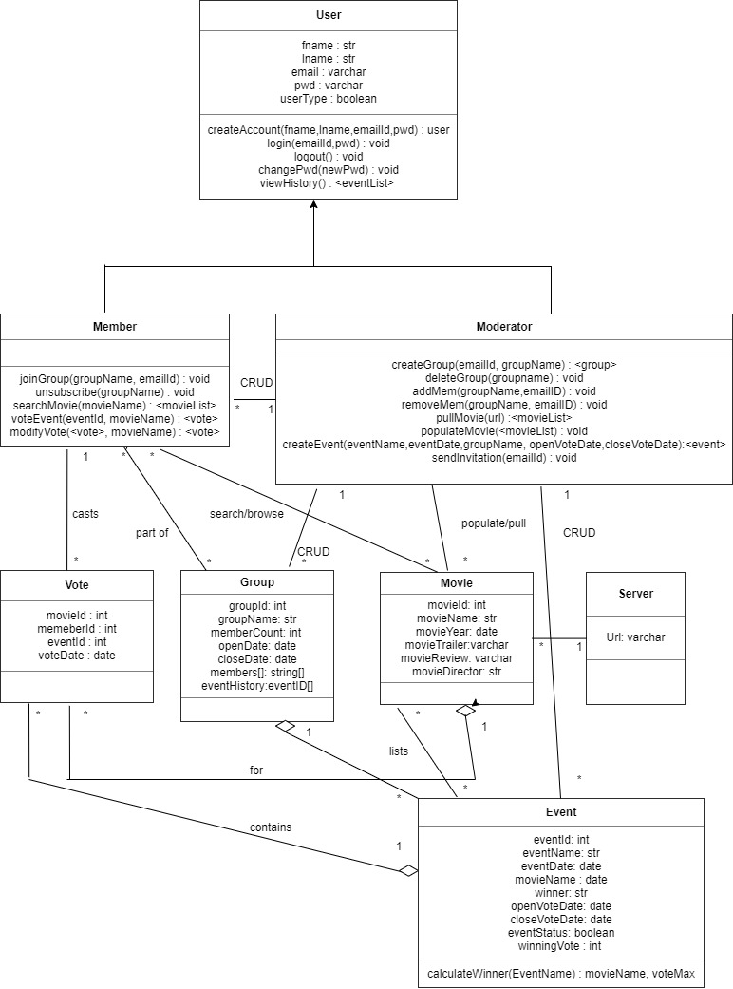
Class Diagram
Review

Slide 23
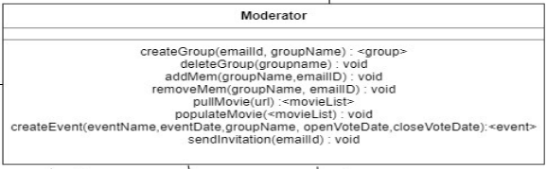
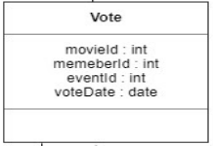
Class Diagram-Valid and appropriate attributes
All attributes in classes didn’t identify whether they are public or private.
Some data types have format error. For example, data type “Date” should start with a capital letter.

Slide 24
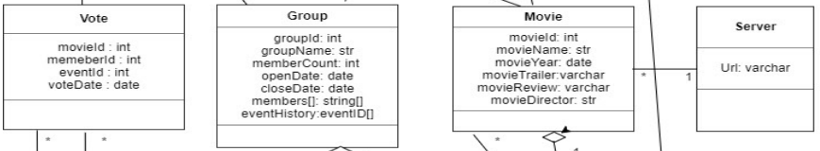
Class Diagram-Valid and appropriate member methods
3. Class Vote, Class Group, Class Movie and Class Server didn’t provide member methods.
4. The return values of many methods are void but should be boolean.
For example, method deleteGroup(groupname): void in Class Moderator.

Slide 25
Class Diagram-Valid and appropriate member methods
5. Some member methods shouldn’t exist in irrelevant entity class, but should be involved in other relevant control class.
For example, the method ”createGroup()” shouldn’t involved in class Moderator but should exist in class GroupsController. In this situation class Moderator is an entity class but not an actor.

Slide 26
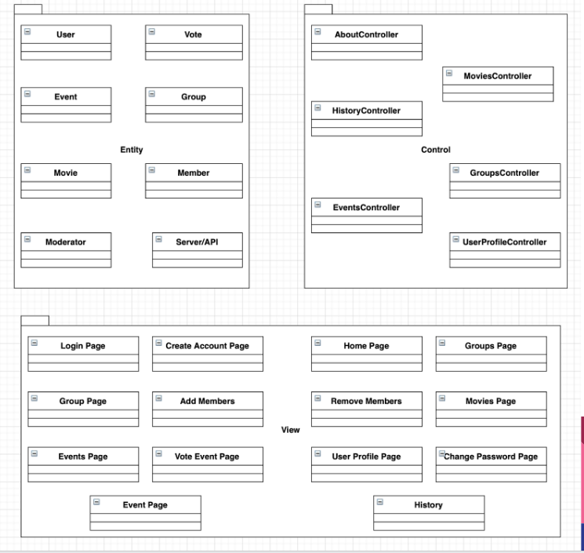
Class Diagram-Overall evaluation
6. Classes in package entity and package control didn’t provide necessary information just like member methods to support sequence diagrams.
Methods in sequence diagram didn’t match with the methods in class diagram.

Slide 27
Sequence diagram review

Slide 28
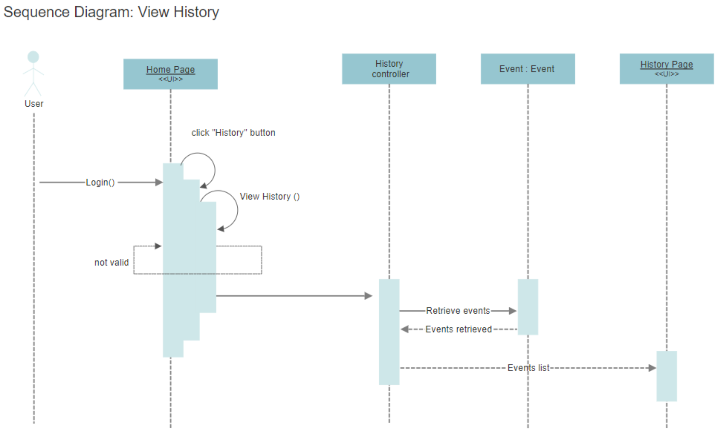
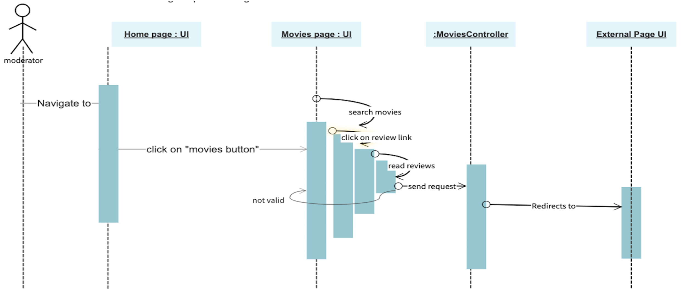
Sequence Diagram Review - 1
All controllers only show the life cycles without the method name.

Slide 29
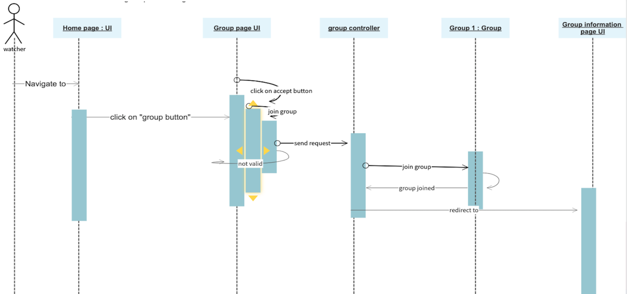
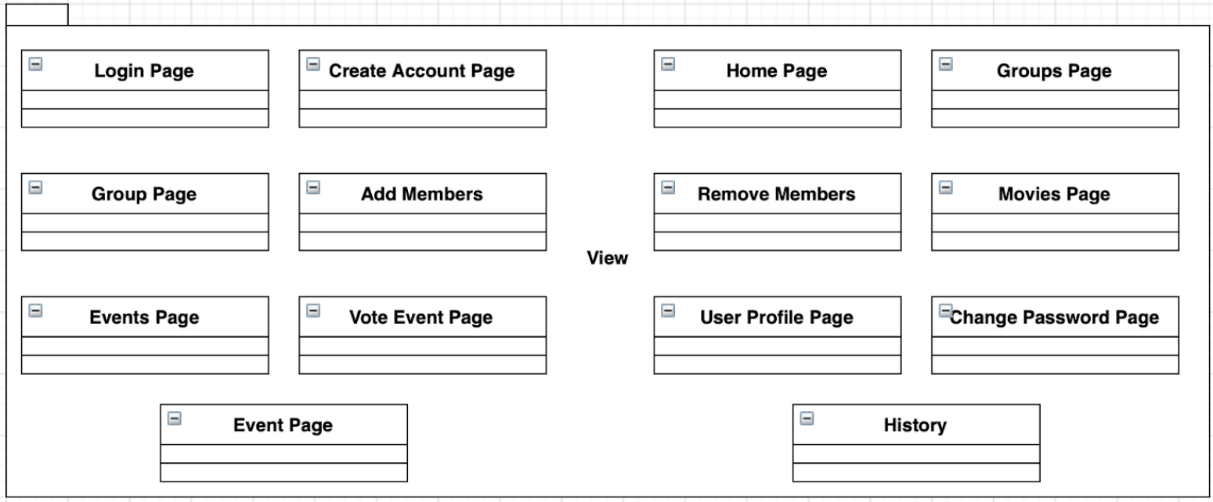
Sequence Diagram Review - 2
Some Pages are not included in the View package.

Slide 30
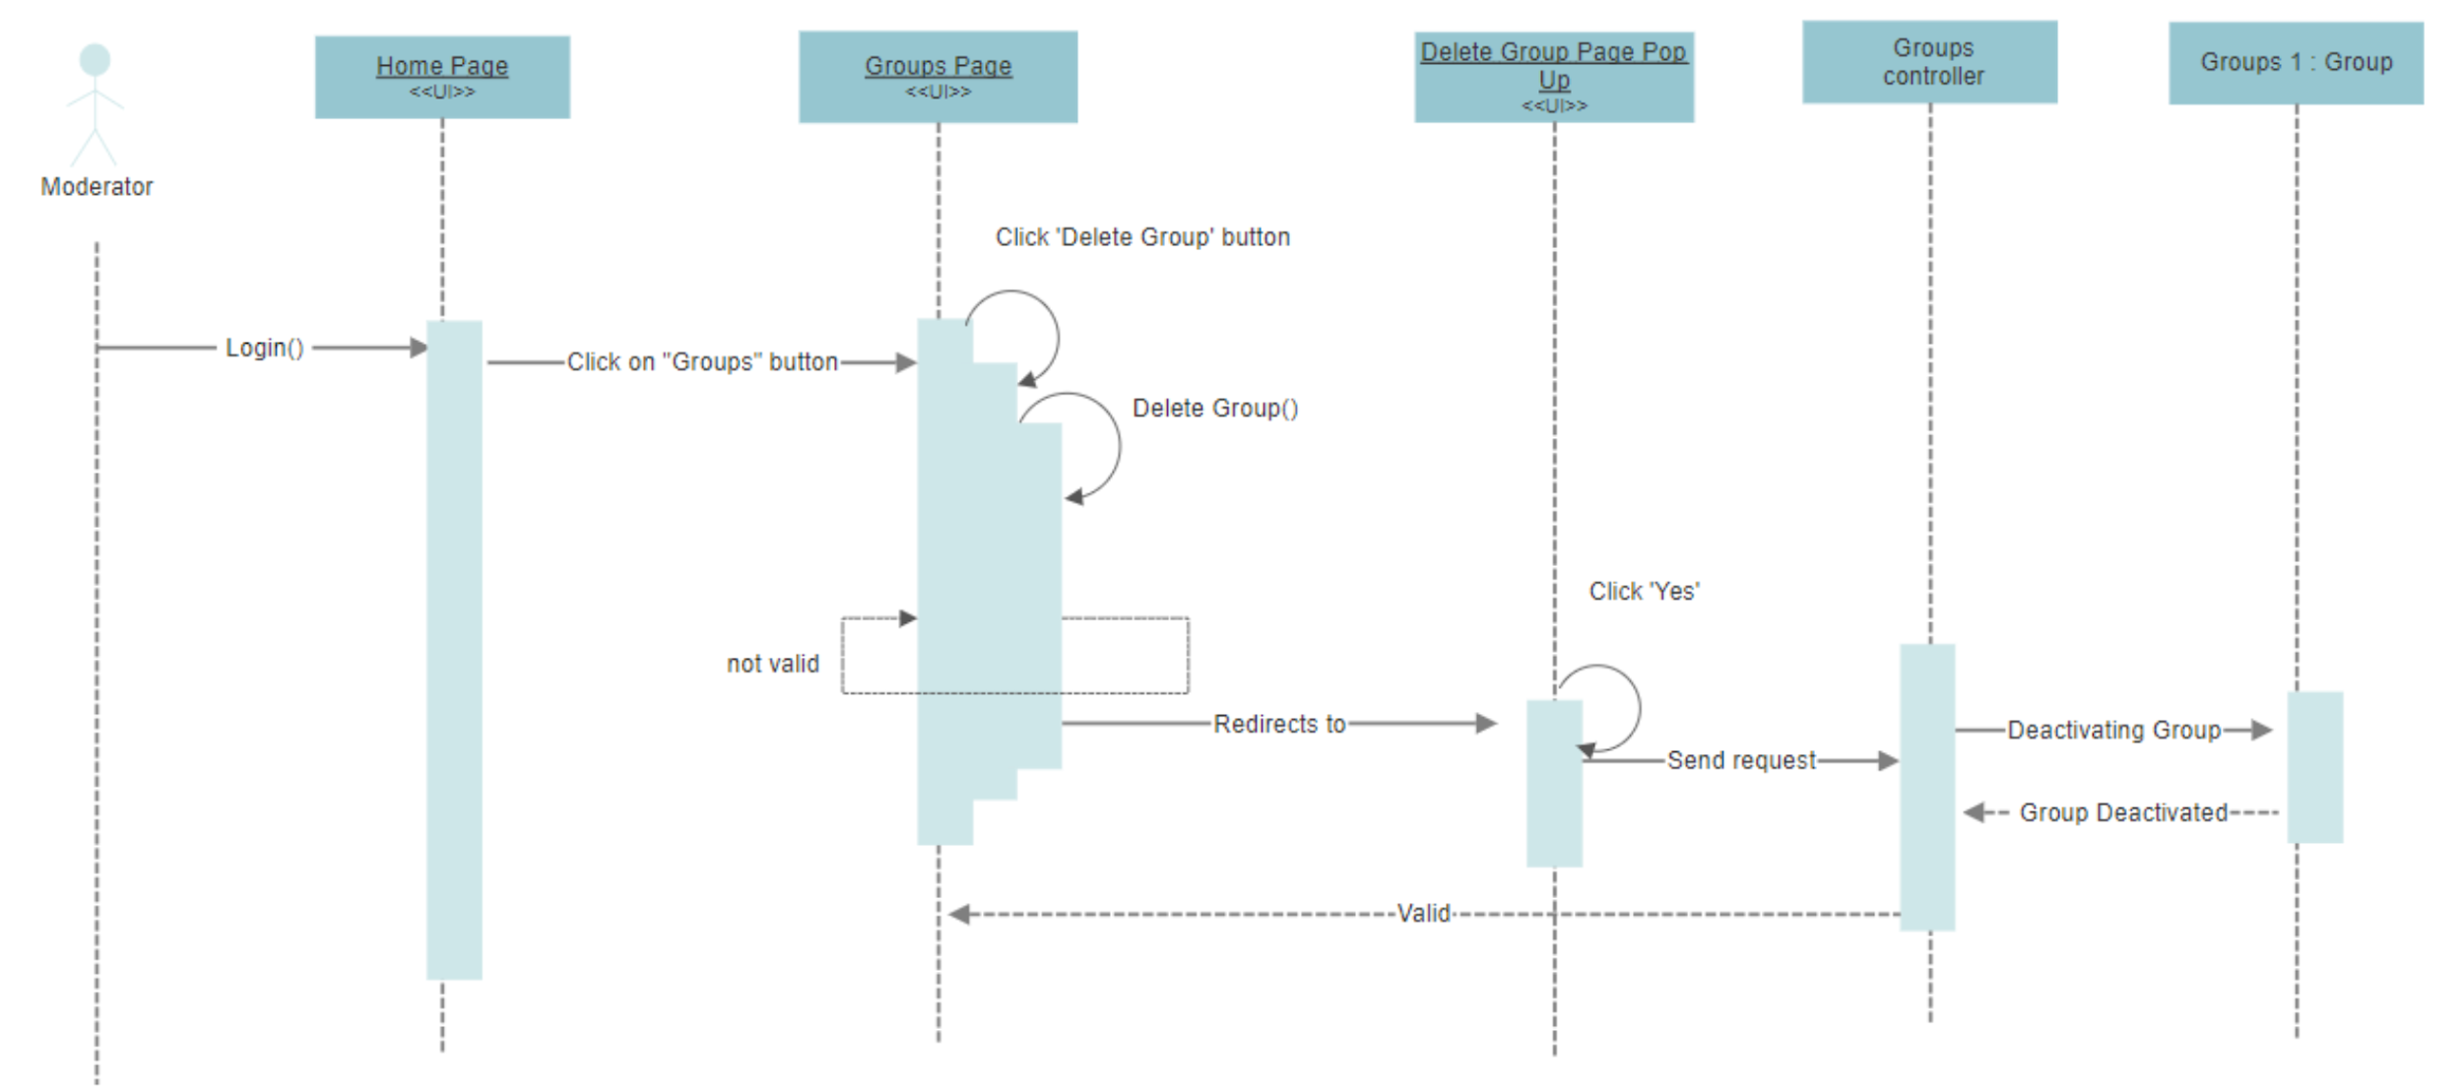
Sequence Diagram Review - 3
When a transaction is done, the sequence diagram doesn’t show the method or other ways to display the change of the page.

Slide 31
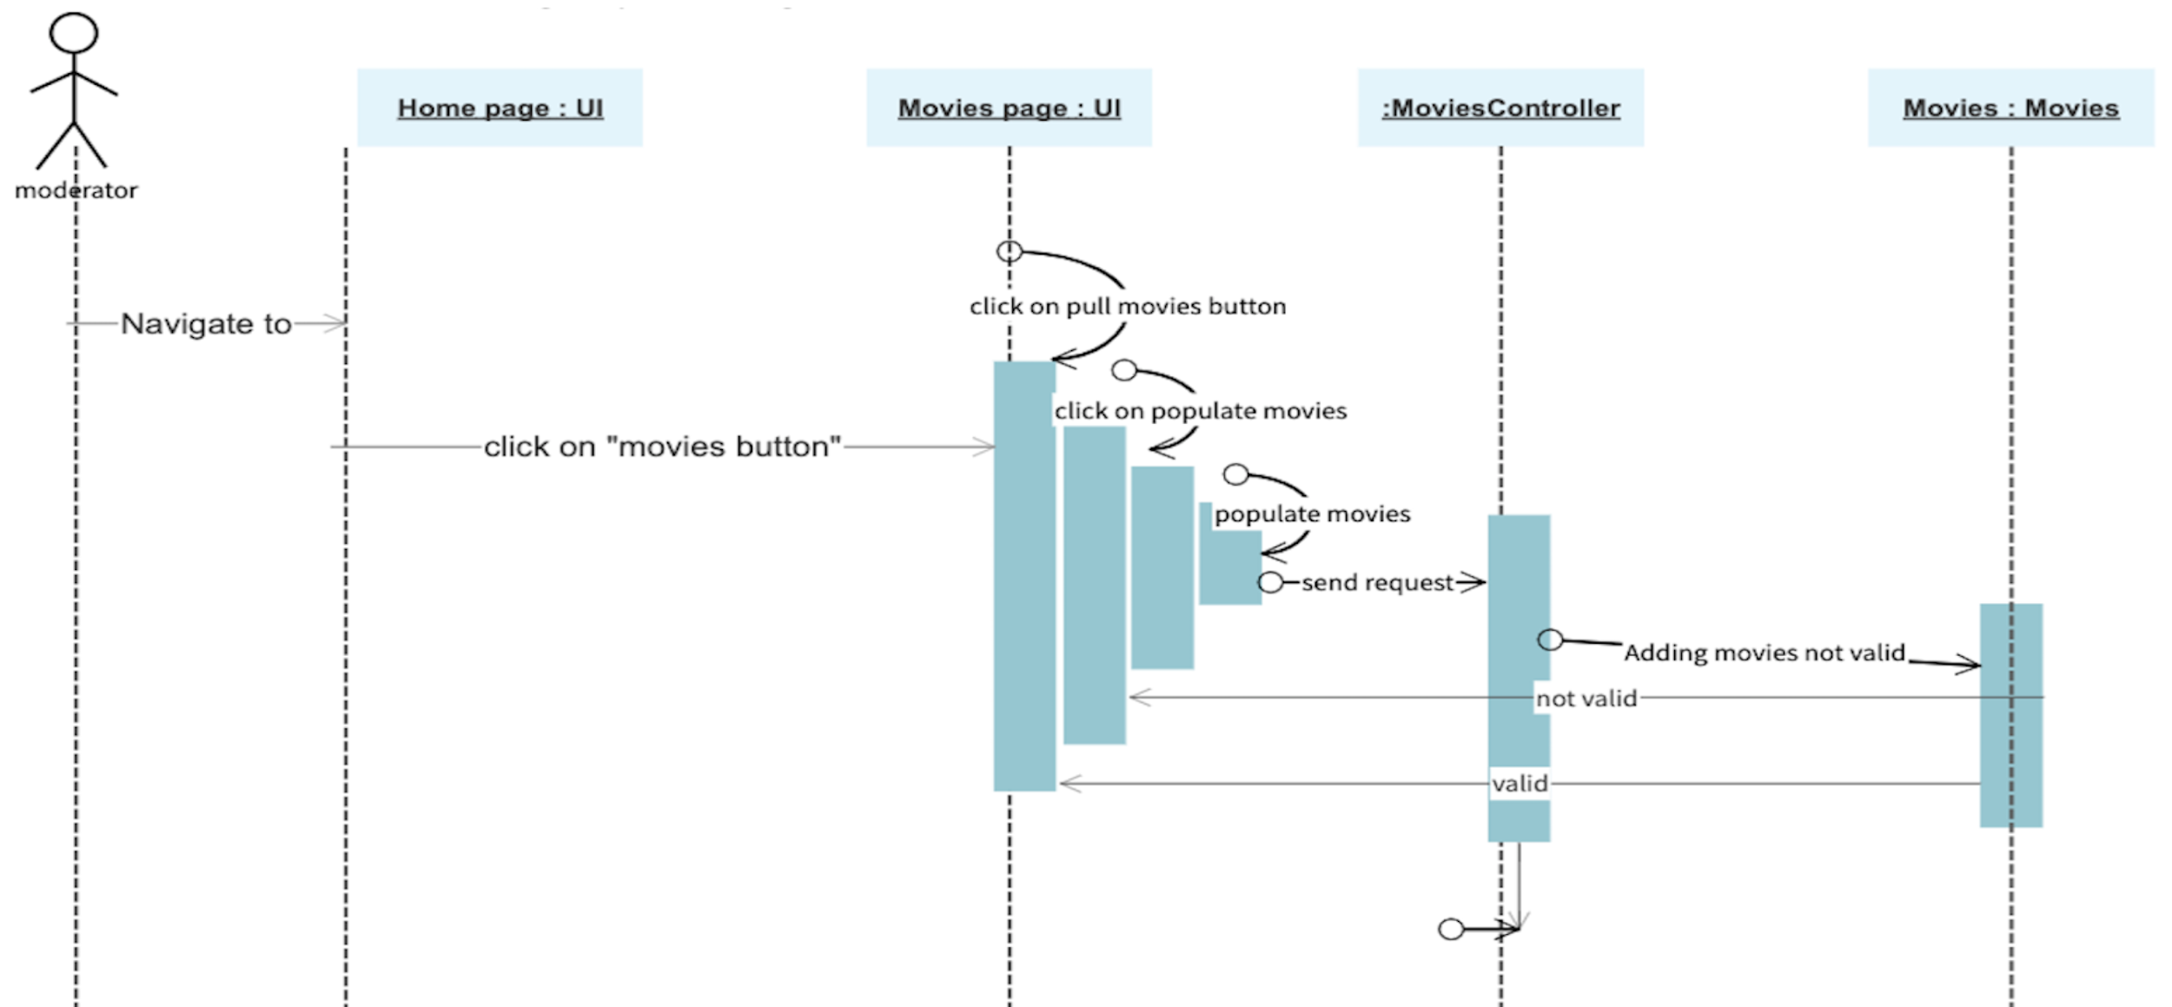
Sequence Diagram Review - 4
Some symbols are not easy to understand.

Slide 32
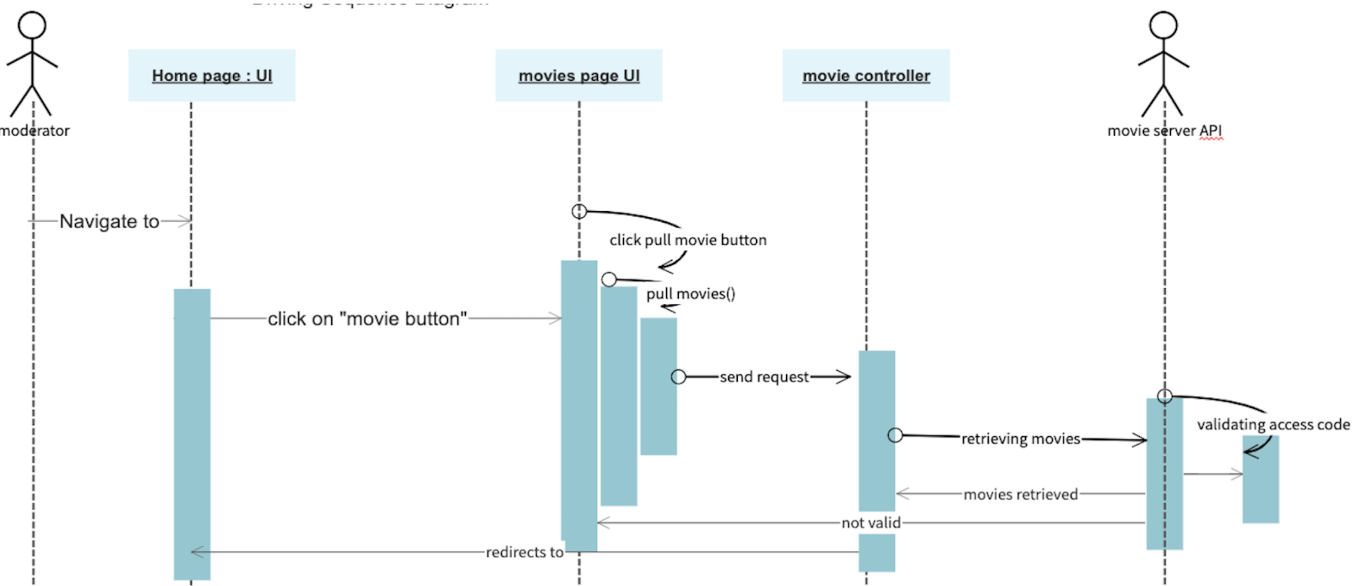
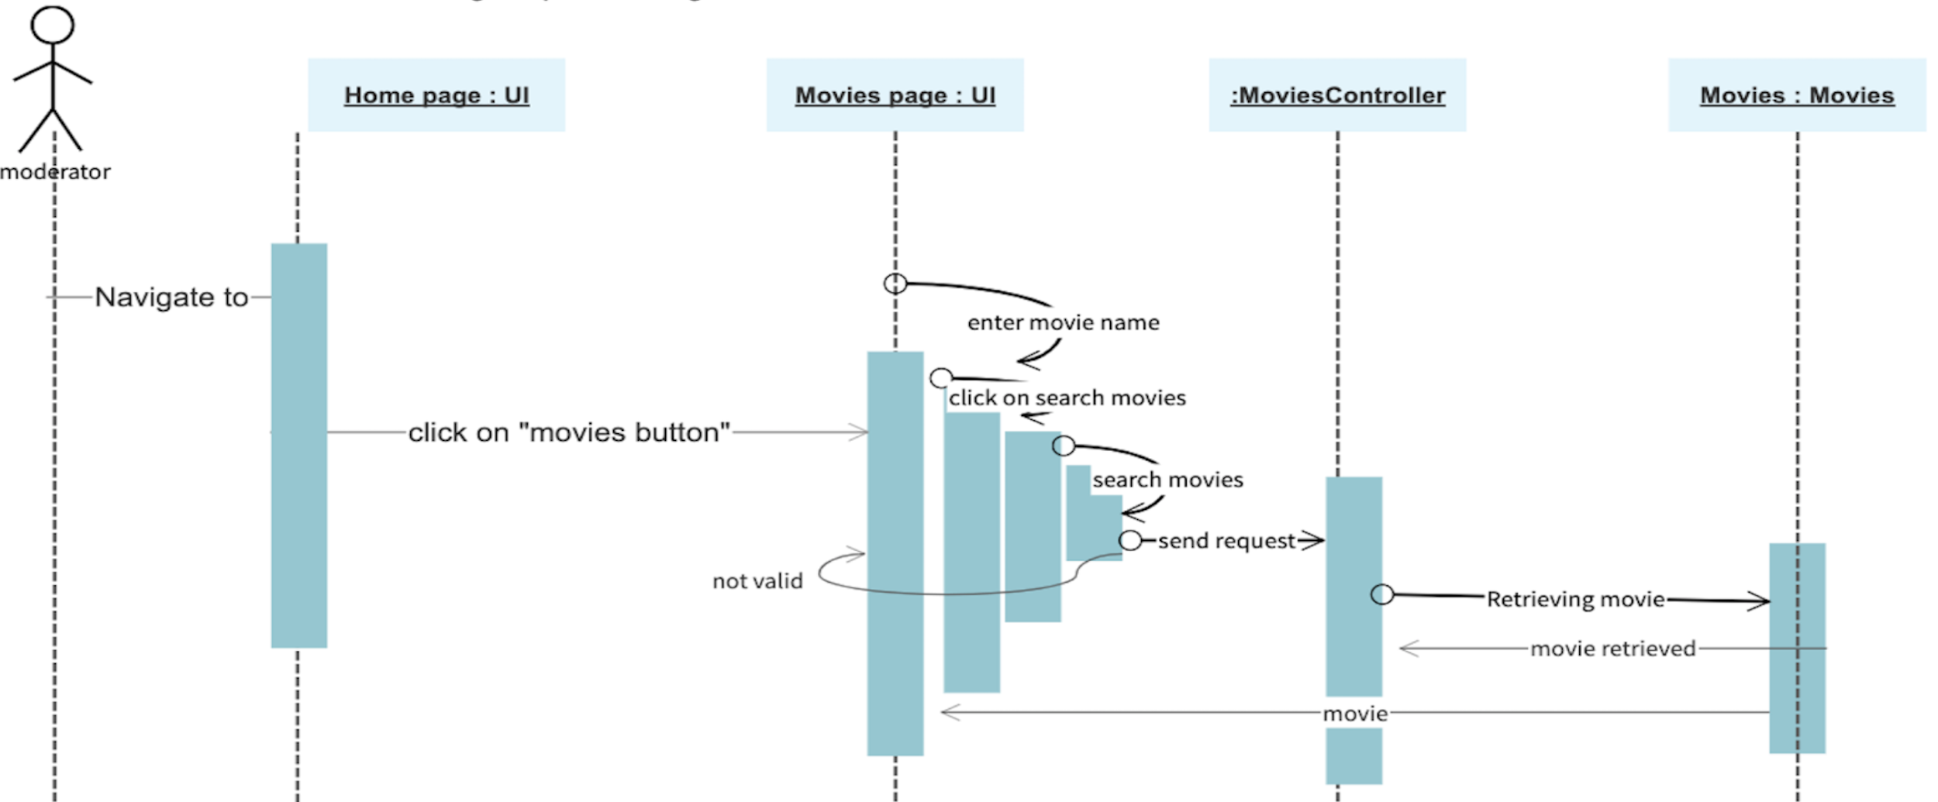
Sequence Diagram Review - 5
Entity classes and API cannot point to the UI directly.

Slide 33
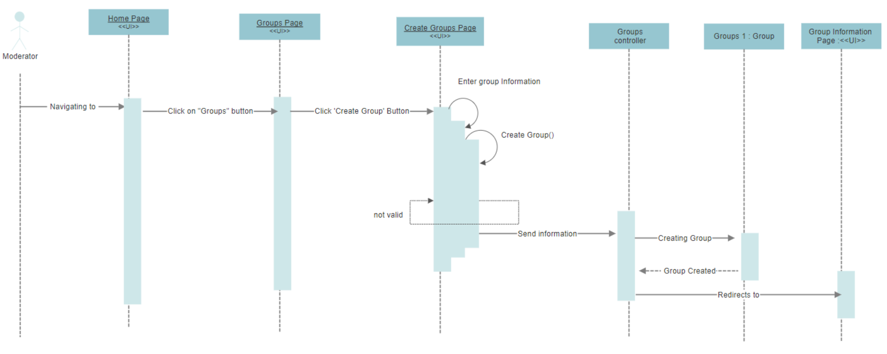
Sequence Diagram Review - 6
When a controller needs to create a new entity, what the controller points at means the start of a entity’s life cycle, not a part of the life cycle.

Slide 34
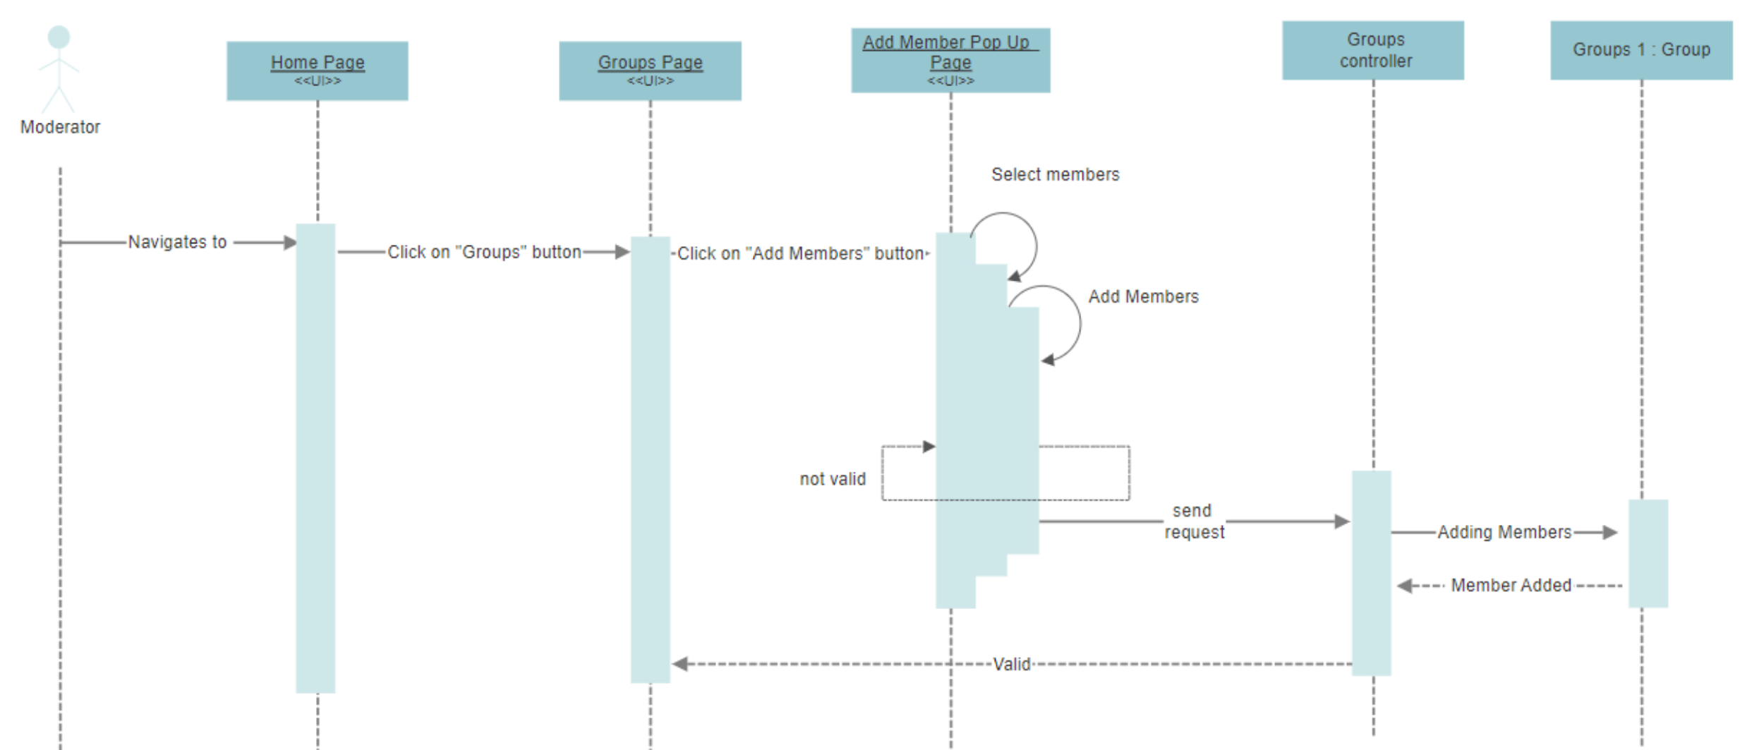
Sequence Diagram Review - 7
The adding member operation should be done after the member accepts to join the group.

Slide 35

Sequence Diagram Review - 8
When a member is removed from a group, it is obvious that we should remove the member from group. However, we also need to remove the group from the member’ group list, either, which is the same as for the adding operation.Because the multiplicity is multi to multi(* *).

Slide 36
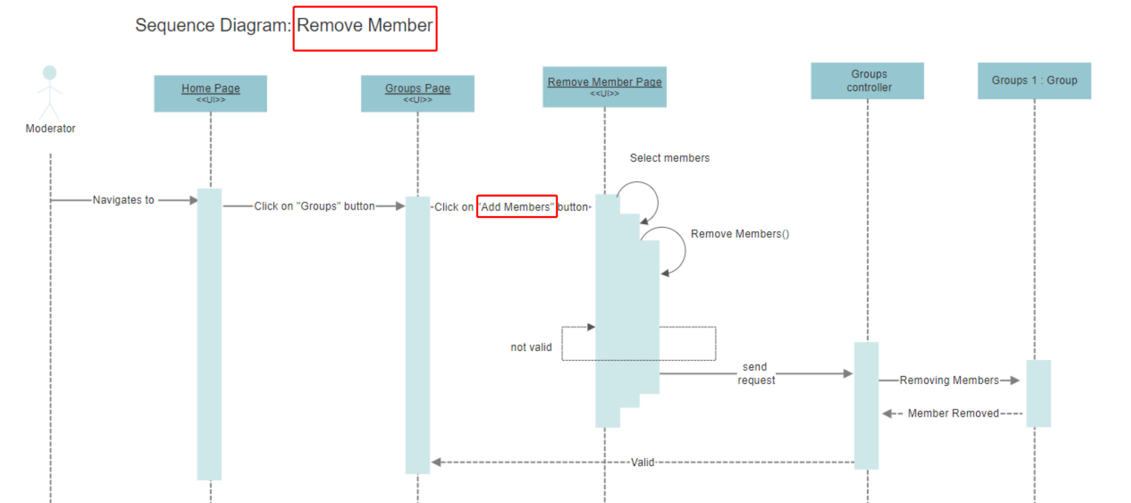
Sequence Diagram Review - 9
A small mistake!

